Slide 1
IT2757
Server and Services Security Management
- SERvER TECHOLOGY AND CONCEPTS

Slide 2
Microsoft Active Directory
An Overview

Slide 3
What is Active Directory?
Microsoft‘s new Directory Service
Called: ADS, NTDS
Successor to LAN Manager Domains
Goals
  Open Standards
  High Scalability
  Simplified Administration
  Compatibility to existing Windows NT systems and applications

Slide 4
Open Standards
LDAP
  Low-Level API to Active Directory
X.500
  Active Directory Structure
  Not fully standard-compliant
DNS
  Resource Location
  Extensions, e. G. „Dynamic DNS“
Kerberos
  Authentication

Slide 5
Active Directory Structure
Hierarchical
Base object
Domain
Domain
Tree
Forest
OU
Domain
Domain
Domain
OU
OU
Tree
Domain
Domain
Objects

Slide 6
Which objects does Active Directory contain?
„old Friends “
  User
  Group
  Computer
New Elements
  Distribution Lists
  System Policies
Application defined custom objects
Described in the Schema

Slide 7
What is the Schema?
Definition of all AD
  Object-Types (Classes)
  Attributes
  Data-Types (Syntaxes)
Can be compared to a Database Schema
ONE consistent Schema inside a single Forest
Extensible

Slide 8
What is a Domain?
AD Base Element (Building Block)
NT 4 Compatible
Physically Implemented on Domain Controllers (DC)
Border for
  Replication Traffic
  System Policies
  Administration
Firma.de

Slide 9
What is an Organizational Unit (OU)?
Implements a Structure inside a Domain
Can be nested as needed
Can not be assigned any rights
Typically used for Administrative Reasons
  e.g. System Policies
LA
New York
Admin
Sales
Admin
Sales

Slide 10
What is a Tree?
Hierarchical Domain Structure inside a single Namespace
  adiscon.com
  la.adiscon.com
  ny.adiscon.com
Transitive Trusts created automatically
Sub-Domain must be added to Root-Domain – otherwise there will be no tree!
adiscon.com
Tree
la.adiscon.com
ny.adiscon.com

Slide 11
What is a Forest?
Combination of Trees
Disjunct Namespaces
  adiscon.de
  adiscon.com
Transitive Trusts created automatically
There is one single tree-root!
Sub-Tree must be added to Root-Tree, otherwise no Forest will be created

Slide 12
The Tree-Root
First Domain installed
Single Schema
Absolutely vital!
Domain
Tree
Forest
OU
Domain
Domain
Domain
OU
OU
Tree
Domain
Domain
Objects

Slide 13
Modeling the physical Structure
Not related to logical Structure
Modeled via „Sites“
A site is well connected via fast Network Links
One Site can home multiple Domains
One Domain can spread across many Sites
Domain Database is stored on Domain Controllers

Slide 14
Sample Site Structure
Logical and physical Structure are totally independent of each other!
Site LA
Site New York
Adiscon.com
sales.adiscon.com
sales.adiscon.com

Slide 15
Which Role can a Server have?
Member Server
Domain Controller
Global Catalog
FSMO
  Special Roles carried out by only a limited set of Servers
  e.g. PDC Emulator
  e.g. Schema Master

Slide 16
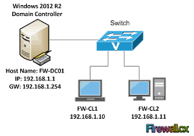
What is a Domain-Controller?
Stores a physical Copy of the Active Directory Database
  Currently a single Domain per DC supported!
  ESE95 Database (MS Exchange)
Logon Services
  Kerberos
  LAN Manager Authentication
Recommendation: always have at least 2 Domain Controllers!

Slide 17
What is a Global Catalog Server?
Answers AD Search Queries
Must be present to successfully logon
Holds a copy of all Objects of the whole Forest…
...but holds only a subset of the Attributes
  User definable
Recommendation: at least one GC per (larger) Site

Slide 18
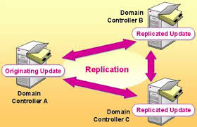
Multi Master Replication
Updates can be applied to ANY Domain Controller
Will be Replicated to each other Domain Controls (inside that Domain) within 15 Minutes
Optimized Algorithm reduces Replication Traffic
Not time based (triggered on demand, only)!

Slide 19
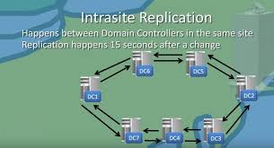
Intra-Sites Replication
All Domain Databases involved
Changes are transmitted compressed
via IP (RPC) or SMTP
  SMTP not within a single domain!
Time Replication occurs can be configured
Volume of Replication Traffic can not be restricted!
Have an Eye on GCs!

Slide 20
Mixed vs. Native Mode?
Mixed Mode supports Coexistence with NT4
  Default
  NT 4 BDCs continue to work
  Enables “Fallback Scenario” during Migration
Only Native Mode supports all AD Features
  More than 40 MB Domain Database Size
  Mostly problem-free „MoveTree“
  Universal Groups, Group nesting
Once you have switched to Native Mode, there is no way back to Mixed Mode!

Slide 21
Are there still Trusts available?
Old fashioned NT 4 Trusts can still be used
  Work like always
  No additional functionality
Most be used to connect different Forests
  Be careful – no common Global Catalog!
Shortcut-Trusts
  Connect frequently used Domains to each other (Performance Optimization)

Slide 22
Shortcut-Trusts
Domain A users frequently access Domain B’s Resources
No Change in logical Structure
Domain
Tree
Forest
OU
Domain A
Domain
Domain
OU
OU
Tree
Domain
Domain B
Objects

Slide 23
Vital for AD: DNS!
DNS is Active Directory’s Locator Service
Without correctly configured DNS no working Active Directory!
  Currently TOP 1 Trouble spot
Can be hosted on non MS-DNS
  Minimum BIND Version 8.1.2
  No special Characters in Computer Names
  Not really an option
  Recommendation: delegate a separate “AD-Zone” on non-MS DNS and use MS-DNS for that zone – saves lots of Trouble!

Slide 24
Who is using Active Directory?
Windows 2000
  Authentication
  System Policies
Directory Enabled Applications
  Please do not overlook them when planning your AD!

Slide 25
What are Directory-Enabled Applications?
Applications directly using and accessing the Active Directory
  e.g. Exchange 2000
  Many more expected!
Typically extend the Schema
May dramatically change usage pattern for Active Directory Resources
  Replication Traffic
  (new Objects, Attributes)
  AD Queries (GCs!)

Slide 26
Active Directory Security
Improved Authentication
Permissions applied via ACLs
  To Objects as whole
  To specific Attributes
Fine-Tuning of Access Permissions possible
Tool-Support to visualize Security Settings currently weak (try Visio!)

Slide 27
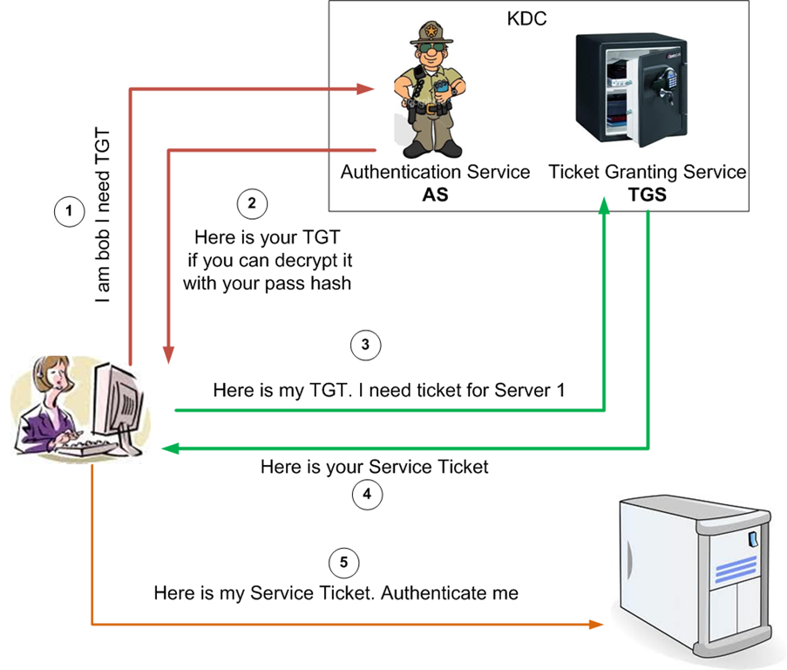
What is Kerberos?
„age-old“ Internet-Standard - mature
Commonly used under Unix
Secure Authentication thanks to Encryption
Standard-Authentication Model under Windows 2000
Microsoft Kerberos not fully compatible to other Kerberos Implementations

Slide 28
Delegation of Administration
Admin rights can be delegated to Users or Groups
  NOT to OUs!
Delegation via Wizards
Currently “Admin Nightmare” – very hard to detect who has rights
  All objects must be viewed separately and manually
  Currently no good tools – but expected to be available in the future
  Microsoft itself also plans to provide additional tools

Slide 29
Inheritance in Active Directory
From Top to Bottom
Inheritance can only be blocked completely
  No IRF like Novell

Slide 30
Groups
Basically, like under NT 4
  Local Groups are assigned Permissions
  Global Groups contain Users
    From a single Domain
    Global Groups are members in Local Groups for Permission assignment
New: Universal Groups
  Can be used everywhere in every Domain (Permissions, Members)
  Implemented via GC
    Replication traffic limits usability

Slide 31
Active Directory Problem Spots
DNS Dependency
No „Merge-Tree“
No Partitioning (only a single Domain per Domain Controller)
Limited Tool-Support
Forest Global Schema
Schema-Modifications can not be undone
Issues will be addressed over time by Microsoft (keep in mind AD is Version 1.0!)

Slide 32
Importance of AD for Microsoft’s Strategy
Most important Product
All new Microsoft Products need or at least work better with Active Directory
  Exchange 2000
  SQL Server 2000
  ...
Bill Gates: „We have bet Microsoft on Active Directory.“

Slide 33
THE END

